Slide 1
Environmental Justice / Ladders of Opportunity
Shari Schaftlein,
Director, Office of Human Environment
September 7, 2016

Slide 2
MassDOT Infra-Space Program: Redesigning Highways to Improve Neighborhood Access and Livability

Slide 3
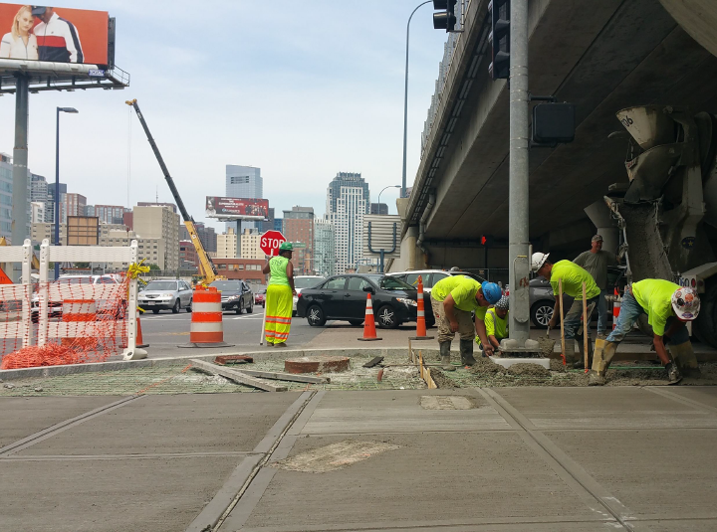
Pedestrian Improvements
Notes:
MA

Slide 4
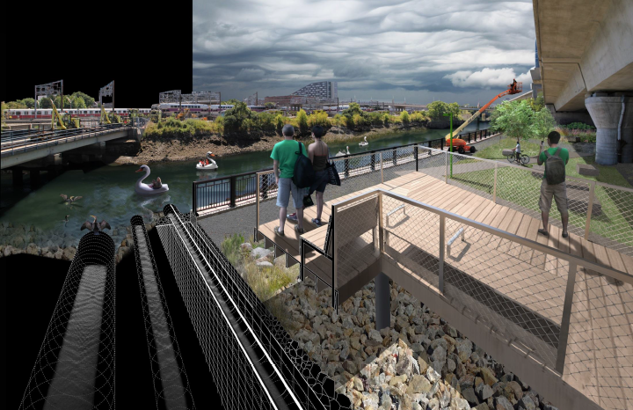
Community Amenity Zones
Notes:
MA-

Slide 5
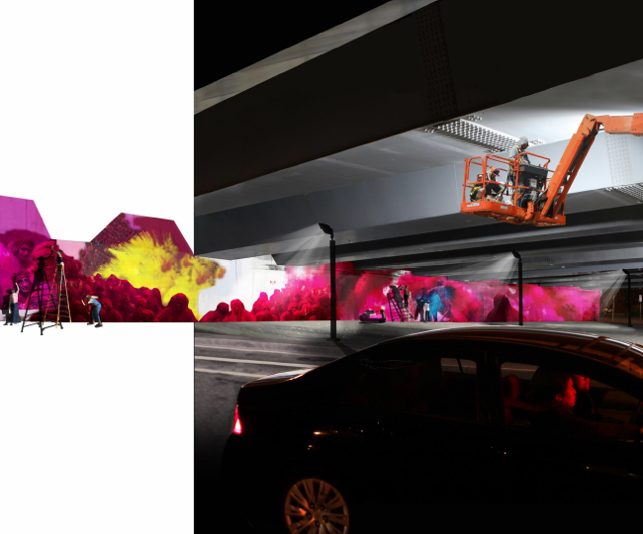
Art Opportunities
Notes:
MA-

Slide 7
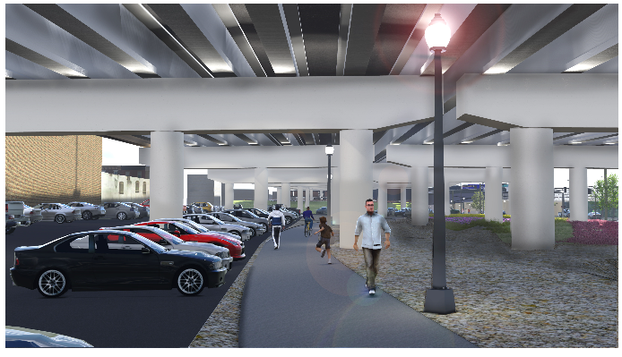
PUBLIC SPACES BENEATH I-95 PA
Notes:
PA

Slide 8
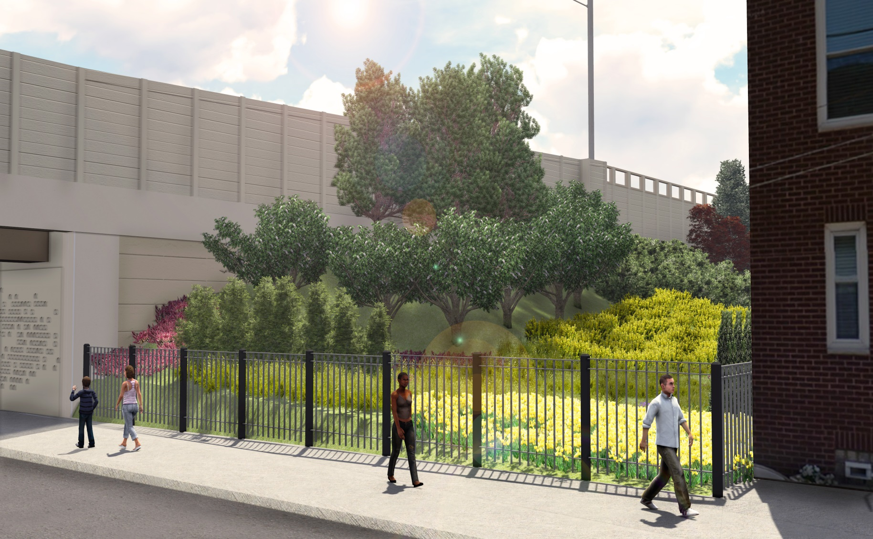
TIERED LANDSCAPING
Notes:
THE 51 MILES OF I-95 IN PENNSYLVANIA HAS BEEN DIVIDED INTO FOUR SECTORS (A THRU D) WHICH HAVE BEEN PRIORITIZED BY PHYSCIAL CONDITIONS. THE MAXIMUM ANNUAL AVERAGE DAILY TRAFFIC IS 180,000 VPD.
The 51 miles of I-95 in Pennsylvania has been divided into four Sectors (A thru D) based on needs. Sector A is where the action is now.
51 Linear Miles (DE to NJ), 325 Lane Miles
Maximum AADT 180,000
1% to 3% Through Traffic
Safety and Geometric Deficiencies
Lane Drops at Interchanges
Lane and Shoulder Widths
Priority by Physical Conditions

Slide 9
BIKE LANESLANE

Slide 10
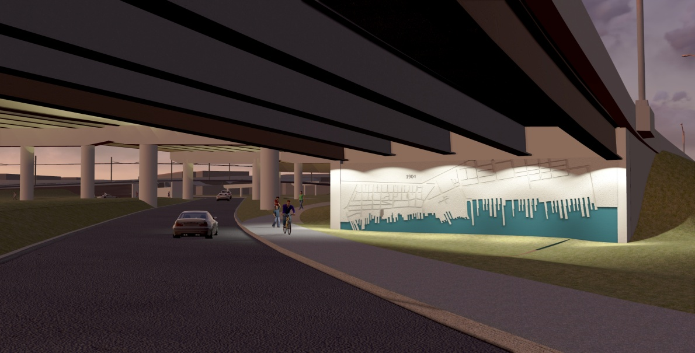
UNIQUE SURFACE TREATMENT

Slide 11
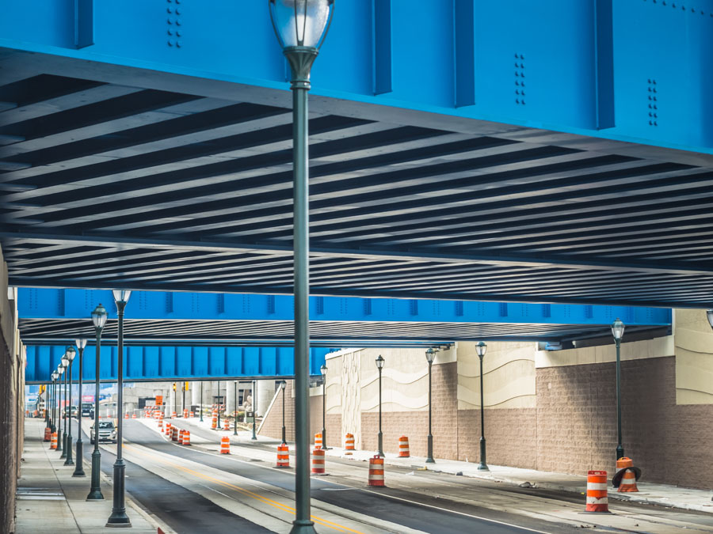
SAFER PEDESTRIAN ENVIRONMENT
Notes:
And here’s the final product. A roadway that is open and inviting for all modes.
Notice the Wave pattern surface treatment and coating on retaining walls.
There's a Barnstone pattern surface treatment for the bridge abutments to replicate original railroad masonry.
Increased vertical clearance for to remove the restriction for commercial vehicles
The redevelopment of Richmond Street as it runs north of Girard Avenue -- which carries cars, as well as the SEPTA Route 15 Trolley -- includes innovative tree plantings, energy-efficient lighting and bike lanes.
The bike lanes will be painted green and will look something like this…
And here’s the final product. A roadway that is open and inviting for all modes.
Notice the Wave pattern surface treatment and coating on retaining walls.
There's a Barnstone pattern surface treatment for the bridge abutments to replicate original railroad masonry.
Increased vertical clearance for to remove the restriction for commercial vehicles
The redevelopment of Richmond Street as it runs north of Girard Avenue -- which carries cars, as well as the SEPTA Route 15 Trolley -- includes innovative tree plantings, energy-efficient lighting and bike lanes.
The bike lanes will be painted green and will look something like this…
And here’s the final product. A roadway that is open and inviting for all modes.
Notice the Wave pattern surface treatment and coating on retaining walls.
There's a Barnstone pattern surface treatment for the bridge abutments to replicate original railroad masonry.
Increased vertical clearance for to remove the restriction for commercial vehicles
The redevelopment of Richmond Street as it runs north of Girard Avenue -- which carries cars, as well as the SEPTA Route 15 Trolley -- includes innovative tree plantings, energy-efficient lighting and bike lanes.
The bike lanes will be painted green and will look something like this…

Slide 12
National Edowment for the Arts
Art Bridges Pawtucket, RI
Notes:
NEA-Art Bridges Pawtucket, RI

Slide 13
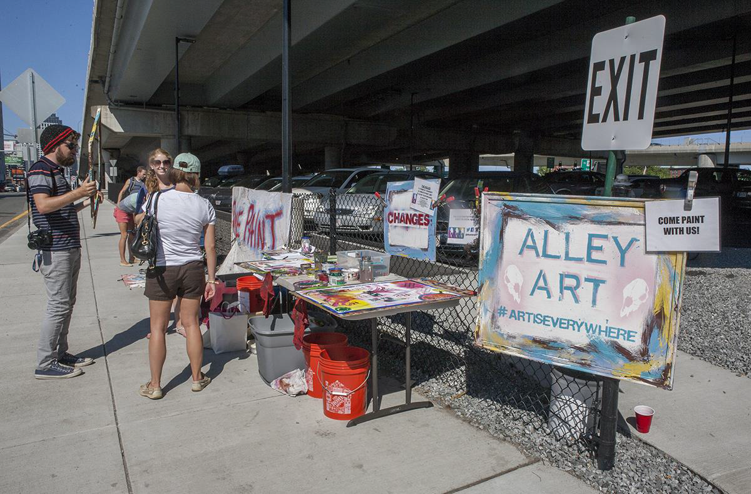
Arts/Community

Slide 14
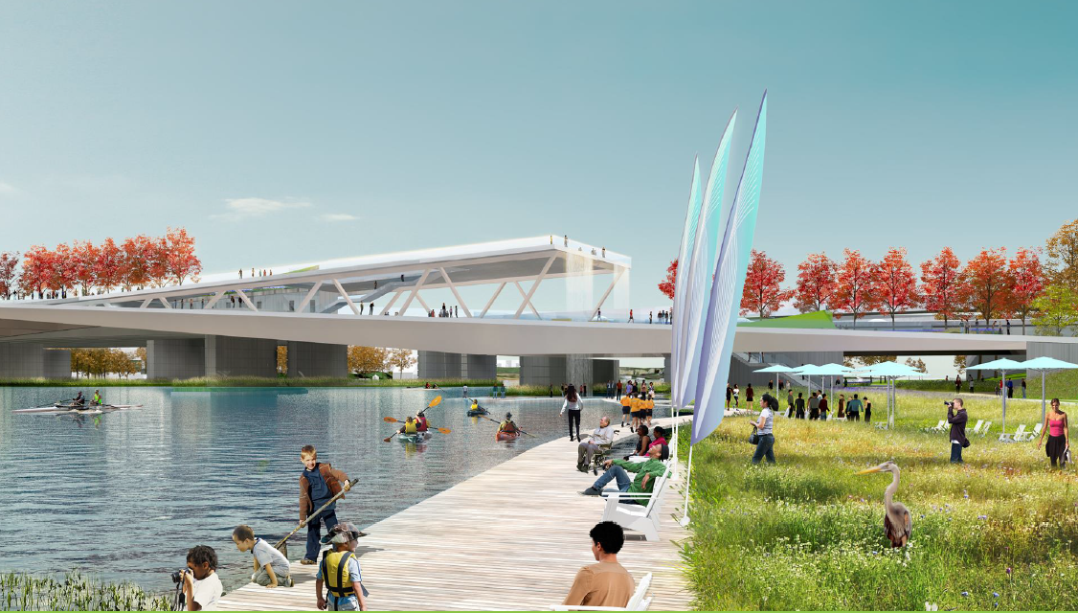
11th Street Bridge Park ART WORKS: Design

Slide 15
I-391 Art Park in Holyoke, MA

Slide 16
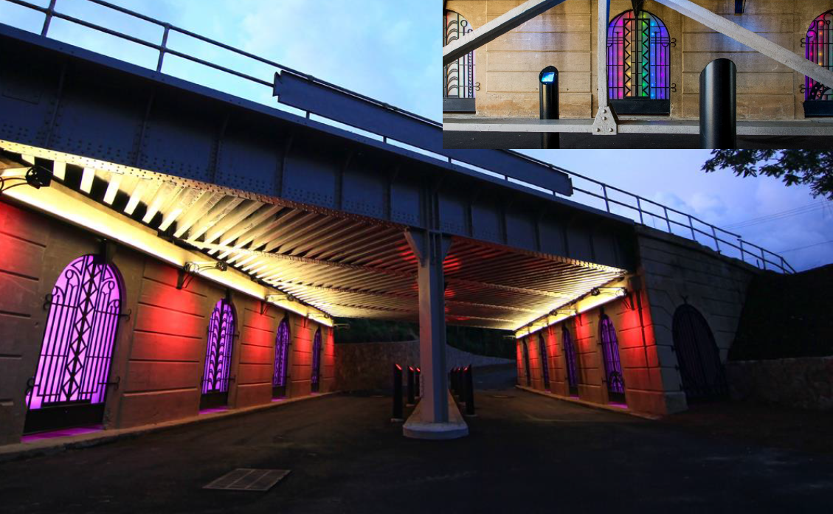
Lighting to Improve Public Safety

Slide 17
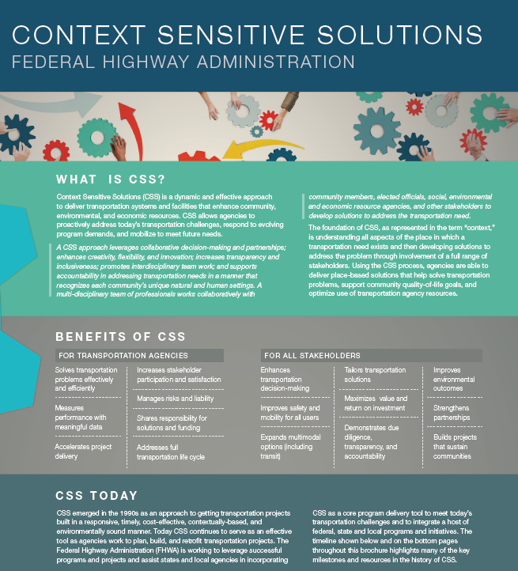
Overview
Ladders/Every Place Counts
Place-Based Initiatives
Livability/CSS
Bike/Ped Networks
Connectivity Performance Measures
Community Connections
Resources
Next Steps
Notes:
Context Sensitive Solutions (CSS) is a fundamental toolbox of principles and practices to help improve timeliness in delivery of transportation projects, and to improve the quality of projects by increasing sensitivity to the local and regional context in which a given project takes place.
CSS principles :
Strive towards a shared stakeholder vision to provide a basis for decisions.
Demonstrate a comprehensive understanding of contexts.
Foster continuing communication and collaboration to achieve consensus.
Exercise flexibility and creativity to shape effective transportation solutions, while preserving and enhancing community and natural environments.

Slide 18
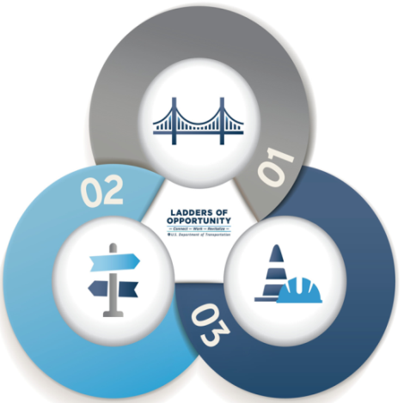
Connecting People to Opportunity: A Vision for Bridging the Divide
Transportation connects people to opportunity and can invigorate opportunity within communities.
Current and future transportation projects should connect and strengthen communities.
Transportation facilities should be built by, for, and with the communities impacted by them.
Development of transportation facilities should meaningfully reflect and incorporate the input of all the people and communities they touch.
https://www.transportation.gov/opportunity
Notes:
This is the big picture overview of Ladders, bullet points.

Slide 19
The U.S. Department of Transportation (DOT) plays a critical role in connecting Americans and communities to economic opportunity. Transportation infrastructure choices made at the Federal, State, and local levels can strengthen communities, create pathways to jobs, and improve the quality of life for all Americans.
Transportation infrastructure can lift up neighborhoods and regions by attracting new opportunities, jobs, and housing.
A multimodal transportation system provides safe, reliable, and affordable connections to employment, education, health care, recreation, and other essential services.
Infrastructure investment creates jobs and paves the way for business, particularly small and disadvantaged business enterprises.
revitalize
connect
work
Notes:
DOT plays a critical role in connecting our communities to economic opportunity. Transportation infrastructure choices made at the Federal, State, and local levels can strengthen communities, create pathways to jobs, and improve the quality of life for all people in the United States.

Slide 20
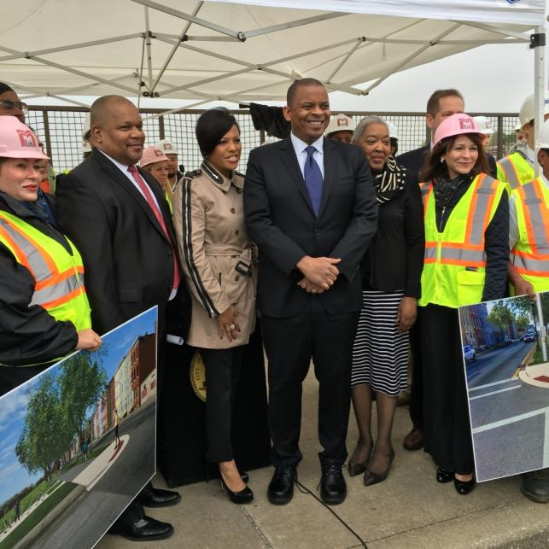
LadderS^{TEP}
Helping Cities:
Advance Transformative Investments
Foster Strategic Alliances
Strengthen Local Capacity
LadderS Pilot Cities:
Atlanta, Baltimore, Baton Rogue,
Charlotte, Indianapolis, Phoenix, and Richmond
Example: Richmond, VA Bicycle and Pedestrian Network Analysis
Public Engagement
BRT Access Focus
Connecting Disadvantaged Neighborhoods, TOD
TEP
Notes:
LadderSTEP helps cities advance transportation projects that revitalize, connect, and support access to economic opportunity.
Advance Transformative Investments: Support the development of projects that help create jobs and spur smart growth economic development opportunities;
Foster Strategic Alliances: Encourage public and private resources to facilitate project partnerships that are mutually beneficial and ensure that the long-term public interest is protected;
Strengthen Local Capacity: Provide technical assistance to communities by sharing expertise in advancing federally-funded projects and informing communities about outside partners that could support project implementation.

Slide 21
Place-based Initiatives
Over 1,200 participating Communities
Over $17 billion dollars in federal resources
(includes technical
assistance)
15 Federal agencies administering Place-based Initiative programs
Increased interagency planning (and a number of potentially duplicative interagency structures)
Notes:
Notes on slides

Slide 22
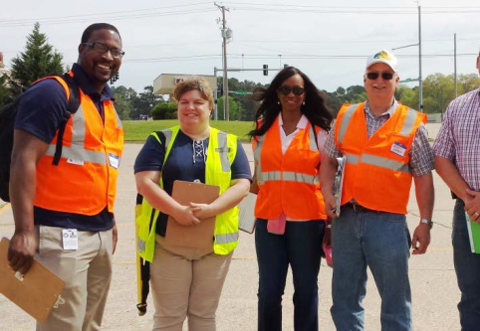
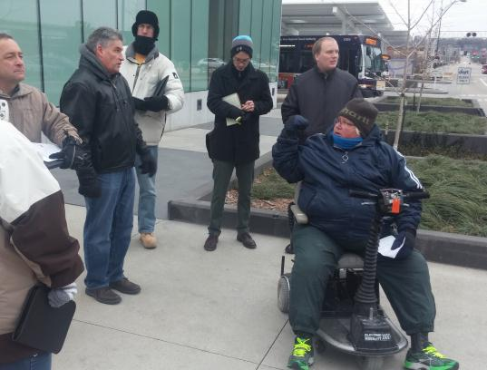
Safer People, Safer Streets Pedestrian and Bicycle Safety Initiative: Identifying and removing barriers to improve safety.
Mayors' Challenge for Safer People, Safer Streets
Road Safety Assessments
Road Safety for Transit Patrons Initiative
Notes:
Safer People, Safer Streets Pedestrian and Bicycle Safety Initiative: Identifying and removing barriers to improve safety.
Mayors' Challenge for Safer People and Safer Streets, a call to action for city officials to advance safety and accessibility goals.
Road Safety Assessments, USDOT convened State, regional, and local transportation officials and stakeholders for on-the-ground safety assessments in every State.
Road Safety for Transit Patrons Initiative - Transit agencies and their customers can often identify gaps in the transportation network, but they do not typically have the authority to fill those gaps. The Road Safety for Transit Patrons Initiative helps to bridge the gap between agencies that have responsibilities for streets and transit agencies. This effort will bring staff from FTA, FHWA and NHTSA – both headquarters and field offices – to provide technical assistance to local and regional planners, engineers, public safety officers and public works professionals who work for transit operators, State DOTs, MPOs, counties and cities. These practitioners, with the assistance of the Federal government, will interact across modes and disciplines, conduct targeted pedestrian and bicycle safety assessments around transit connections, develop best practices to improve safety for riders who access transit by foot, bike, or assistive mobility devices and take steps to build networks of sidewalks, bikeways, crosswalks, signals, and other infrastructure that build safer, more enjoyable connections to our public transportation investments..

Slide 23
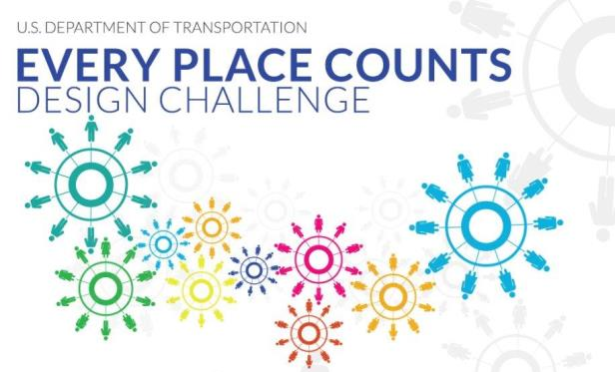
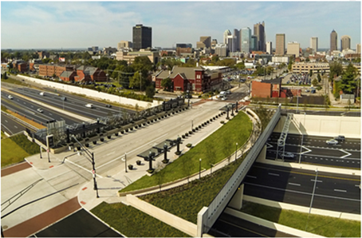
Every Place Counts Design Challenge: Raising awareness and identifying innovative community design solutions that bridge the infrastructure divide and reconnect people to opportunity.
Community Visioning Sessions
Spokane, WA
Nashville, TN
Philadelphia, PA
St Paul-Minneapolis, MN
Notes:
EPC Goals:
Encourage communities to reimagine existing transportation projects via innovative and restorative infrastructure design that corrects past mistakes; reconnects people and neighborhoods to opportunity; and reinvigorates opportunity within communities.
Empower communities and decisionmakers to work together to develop context-sensitive design solutions that reflect and incorporate the input of the people and communities they impact.
In July DOT held four community visioning design charrettes in Spokane, WA, Nashville, TN, Philadelphia, PA, and in the St-Paul-Minneapolis area.

Slide 24
Transportation Livability for Individuals and Communities
Promote Equitable, Affordable Housing
Enhance Economic Competitiveness
Support Existing Communities
Value Communities and Neighborhoods
Coordinate Policies and Leverage Investment
Provide More Transportation Choices
Notes:
Livability is about tying the quality and location of transportation facilities to broader opportunities such as access to good jobs, affordable housing, quality schools, and safer streets and roads.
Six Principles:
Provide more transportation choices
Expand location and energy efficient housing choice
Improve economic competitiveness
Target federal funding towards existing communities (to advance livability)
Align federal policies and funding
Enhance the unique characteristics of all communities
The FHWA supports livable communities through funding transportation related projects and sponsoring activities like Context Sensitive Solutions and facilitating public involvement efforts that enable people to live closer to jobs, recreation, essential services, and help reduce pollution.
FHWA also has numerous livability tools such as a connectivity evaluation resource, community vision metrics web-based tools, and a livability communities discussion board.

Slide 25
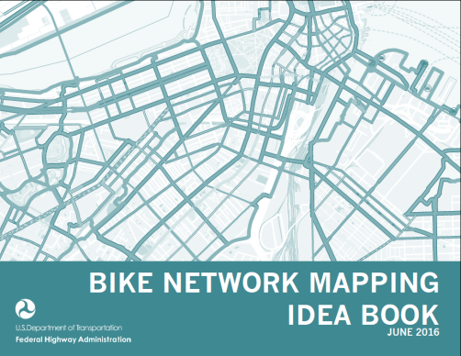
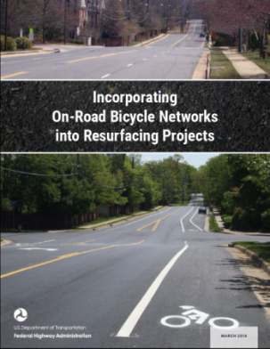
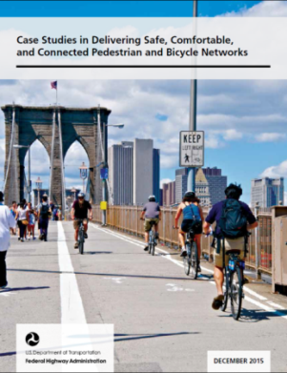
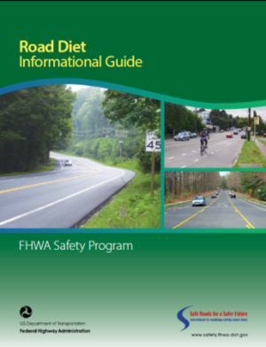
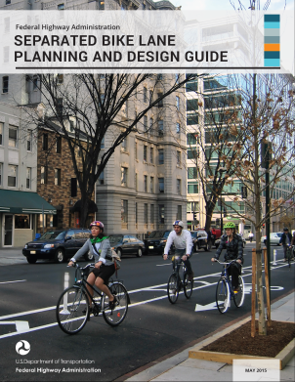
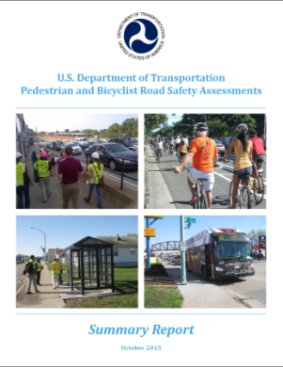
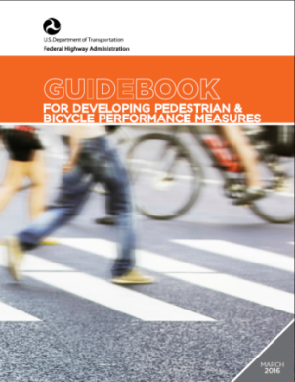
Improving Pedestrian and Bicycle Networks
Notes:
FHWA’s has numerous resources to assist practitioners with improving bike/ped networks and connectivity. One example includes FHWA’s Guidebook for Developing Pedestrian and Bicycle Performance Measures highlights measures that impact of Access to Community Destinations, Access to Jobs, Job Creation, Physical Activity and Health, Population Served by Walk/Bike/Transit, and Transportation-Disadvantaged Population Served.

Slide 26
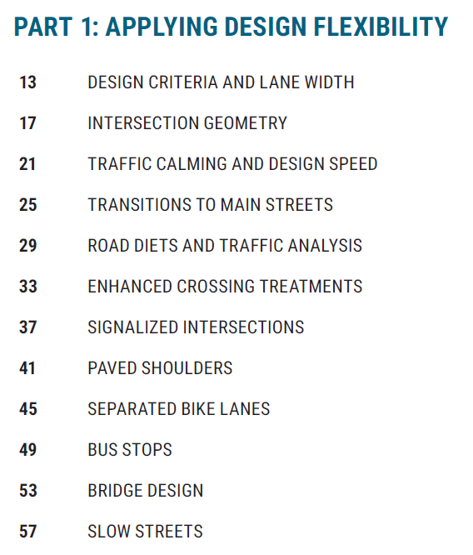
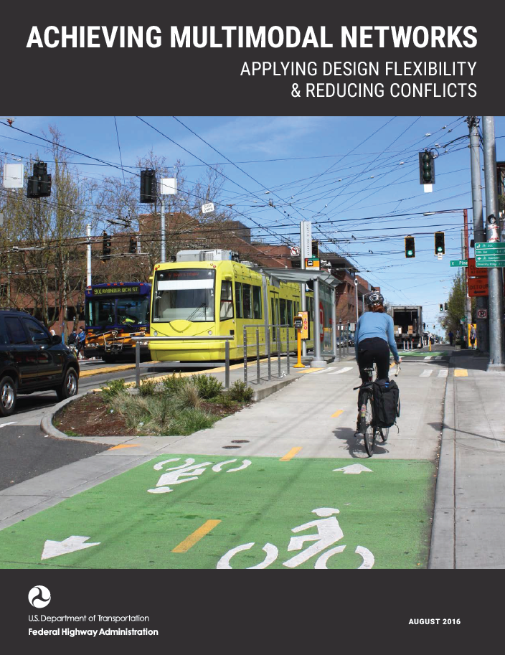
Achieving Multimodal Networks: Applying Design Flexibility and Reducing Conflicts
Highlights ways to apply design flexibility, while focusing on reducing multimodal conflicts and achieving connected networks
Help practitioners address topics such as:
Intersection design
Road diets
Pedestrian crossing treatments
Transit and school access
Freight
Accessibility
Notes:
Achieving Multimodal Networks: Applying Design Flexibility and Reducing Conflicts
Available at http://www.fhwa.dot.gov/environment/bicycle_pedestrian

Slide 27
Connectivity Performance Measures Guidebook
Guide to Performance Management: The why and how of measuring access to opportunity
Advisory Group
Development of a Draft Guidebook
Federal and State officials convened at Performance Measures Workshop in July
Second Performance Measures Workshop, Nov. 2016
Final document and outreach, January 2017
Notes:
With support from GICD, FHWA held the first of two workshops on connectivity performance measures on July 29, 2016 in Denver, CO. Over twenty State and Federal DOT representatives from WA, CO, and UT were in attendance. The second workshop is scheduled in the Southern half of the U.S. in early/mid November
The workshop was successful in allowing participants to share their experiences on public outreach, transportation connectivity performance measures, available tools, notable examples, and methodologies that transportation officials may find useful for improving access to opportunity and other connectivity measures.

Slide 28
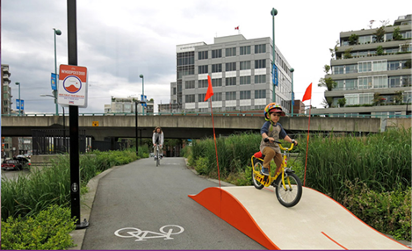
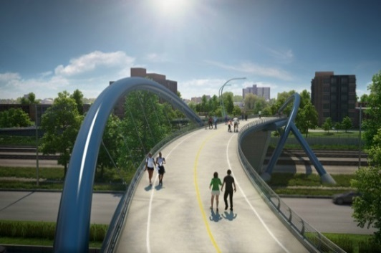
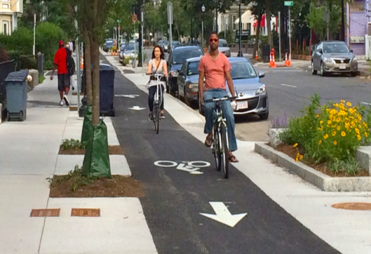
Community Connections: An EDC-4 Initiative
Why?
Aspects
Many cities have elevated and surface highways that have reached the end of their useful life. The timing is ripe to provide a national framework to consider removal and retrofit options to reconnect and revitalize urban cores and adjacent communities.
Ready
A number of states and MPOs have assessed the need to improve community connections that meet community, project, and system objectives. (Examples: I-71 capping, Columbus, OH; I-90 in Seattle, WA and Gibbs Street Bridge, Portland, OR).
National
Create visibility and awareness of the role transportation can play in supporting community revitalization efforts
DOTs and MPOs need assistance in advancing projects that connect or reconnect communities. Through modification of traditional project planning, development & design approaches, transportation practitioners can better exercise judgement to improve community connections to meet both project and system objectives.
Notes:
The Community Connections Initiative will encourage State and local partners to ensure that transportation projects meet the needs of their respective communities and improve connectivity between disadvantaged populations and essential services.
As an example, in EDC-4, the Community Connections Initiative supports new policies for flexible highway design, which FHWA supports in effort to promote design that best satisfy both the purpose of projects and the needs of the surrounding community. Many highways have reached the end of their lifecycle, which presents a valuable opportunity to invigorate affected cities through the retrofit or removal of aging infrastructure.
Lastly, Community Connections will include strategies and tools that can be seamlessly integrated with ongoing and future project planning and development. These strategies, which include visualization tools, public involvement techniques, and performance-based practical design methods, can be seamlessly integrated into ongoing project planning, project development, and design processes.
Collectively, these promote proven strategies will help to assess the impacts of transportation infrastructure on communities and increase awareness among transportation professionals of methods to design transportation projects that engender community revitalization.

Slide 29
Benefits
Community Connections: An EDC-4 Initiative
Context-sensitive design rather than a one-size-fits-all solution
Improved walkability, bicycle safety, and access to essential services
Residents able to pursue economic opportunities due to increased mobility
Next Steps
Webinars
September 8, 1pm – 2:30pm (EST)
September 22, 1pm – 2:30pm (EST)
Regional Summits
Baltimore – Oct 18-19; Minneapolis/St. Paul – Oct 25-26;
Albany – Nov 2-3; Portland – Nov 29-30; Sacramento – Dec 1-2;
Austin – Dec 6-7; Orlando – Dec 14 -15
Implementation Plan
https://www.fhwa.dot.gov/innovation/everydaycounts/edc_4/
Notes:
Benefits
1st bullets on slide is process benefit. Second and third bullets are outcome benefits
EDC-4 will continue to take advantage of proven innovations and enhanced business processes promoted through previous EDC initiatives to facilitate greater efficiency at the state and local levels, saving time and resources that can be used to deliver more projects for the same money. By advancing the most efficient 21st century solutions, the highway community is making every day count to ensure our roads and bridges are built better, faster and smarter.
Dates of upcoming webinars and regional summits for EDC-4 are on the screen. Please visit the EDC website for more information.

Slide 30
Livability Resources
Recent Publications
Livability in Transportation Guidebook
The Role of FHWA Programs in Livability
Creating Livable Communities
Livability in the US and Sweden Summary Report
Regional Livability Workshop Summaries
Context Sensitive Solutions (CSS) Brochure
Coming Soon!
Community Impact Assessment Guidebook Update
CSS Targeted Technical Assistance Summary Reports
For More Information:
www.fhwa.dot.gov/livability
Notes:
This slide provides a list of our recent and coming soon livability publications.
One particularly resource to mention is FHWA’s recently published at CSS brochure that highlights the history of CSS its benefits and how it has been used to engage the public on projects to transform communities through transportation. The brochure provides information on the relationship between CSS and several processes and activities such as NEPA, Environmental Justice, Sustainability, Livability, Design Flexibility and Performance Based Practical Design.

Slide 31
Multimodal Resources
Recently Completed
Pursuing Equity in Pedestrian and Bicycle Planning
PlanWorks: Bicycle and Pedestrians
Transportation Alternatives Program Performance Management Guidebook
Guidebook for Developing Pedestrian and Bicycle Performance Measures
Bike Network Mapping Idea Book
Incorporating On-Road Bicycle Networks into Resurfacing Projects
Separated Bike Lane Planning and Design Guide
Case Studies in Delivering Safe, Comfortable and Connected Pedestrian and Bicycle Networks
Bicycle Network Planning & Facility Design Approaches in the Netherlands and the United States
Road Diet Informational Guide
Pedestrian and Bicyclists Road Safety Assessments Summary Report
Achieving Multimodal Networks: Applying Design Flexibility and Reducing Conflicts
Coming Soon!
Strategic Agenda for Pedestrian and Bicycle Transportation
Small Town and Rural Multimodal Networks Guide
Guide to Performance Management: The Why and How of Measuring Access to Opportunity
For More Information: www.fhwa.dot.gov/environment/bicycle_pedestrian
Notes:
Recently Completed Resources
The Pursuing Equity in Pedestrian and Bicycle Planning white paper discusses equity considerations in the pedestrian and bicycle planning process.
The Guidebook for Developing Pedestrian and Bicycle Performance Measures is intended to help communities develop performance measures that can fully integrate pedestrian and bicycle planning in ongoing performance management activities.
The Transportation Alternatives Program Performance Management Guidebook provides sample performance objectives and measures that States, Metropolitan Planning Organizations, and project sponsors may consider as they administer, implement, and evaluate TAP projects and program outcomes.
The Bike Network Mapping Idea Book is a resource that shows examples of maps at different scales, demonstrates a range of mapping strategies, techniques, and approaches.
The Incorporating On-Road Bicycle Networks into Resurfacing Projects workbook provides recommendations for how roadway agencies can integrate bicycle facilities into their resurfacing program.
The Separated Bike Lane Planning and Design Guide outlines planning considerations and design options for separated bike lanes.
The Case Studies in Delivering Safe, Comfortable and Connected Pedestrian and Bicycle Networks report highlights specific projects that contributed to connected networks in communities throughout the U.S.
The Bicycle Network Planning & Facility Design Approaches in the Netherlands and the United States report explores similarities and differences in the approach to bicycle network planning and facility design in the Netherlands and the United States
Coming Soon!
The Achieving Multimodal Networks: Applying Design Flexibility and Reducing Conflicts report will highlight examples of design flexibility and planning and design improvement opportunities in locations where various transportation modes come together.
The Strategic Agenda for Pedestrian and Bicycle Transportation will provide a strategic action framework focused on networks, safety, equity, and trips. It will inform future investments, coordinate policies, and promote partnerships.
The Small Town and Rural Multimodal Networks Guide will highlight strategies and designs for building connected pedestrian and bicycle networks in small towns and rural areas.

Slide 32
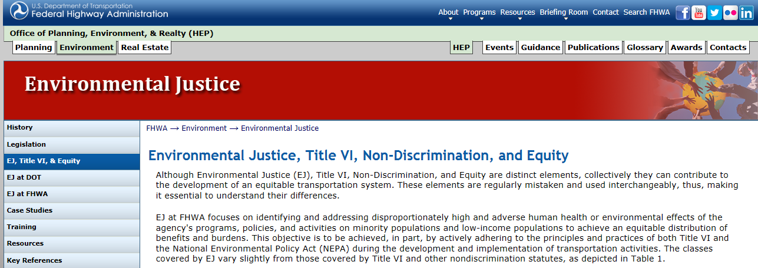
FHWA Title VI and EJ Activities
Environmental Justice
DOT EJ Strategy Update
EJ Order Updates
NHI EJ Course Updates
EJ FAQs Updates
EJ Website Updates
EJ Work Groups – Federal EJ IWG/
DOT/FHWA EJ Workgroup
Title VI
Title VI Order Update
Title VI Taskforce
Virtual Civil Rights Symposium
Technical Assistance/Guidance
Internal Programmatic Reviews
Desk Reference Guide
http://www.fhwa.dot.gov/environment/environmental_justice/equity/
http://www.fhwa.dot.gov/environment/environmental_justice/ej_at_fhwa/
Notes:
T6 Task Force: interdisciplinary Task Force to ensure effective coordination, transparency, and quality delivery of the Plan
T6 Technical Assistance/Guidance: assess all existing Title VI documents from FHWA Headquarters and the Resource Center to create practical, plain-language resources for all internal and external stakeholders.
T6 Compliance Training: deliver practical, interdisciplinary, and compliance-oriented Title VI training to emphasize State/Division actions, data analysis, and internal controls, with real-world examples.
T6 Internal Review: FHWA Program Management Improvement Team (PMIT) will independently analyze both the programmatic and the on-the-ground implementation of Title VI, nationwide and produce report with recommendations

Slide 33
FHWA Environmental Justice Resources
Recently Developed
Under Development
EJ and Climate Change Fact Sheet (2016)
EJ: The New Normal for Transportation. FHWA Public Roads, May/April 2016
EJ Reference Guide (2015)
EJ Emerging Trends and Best Practices Guidebook (2011)
Practitioners’ EJ Roadmap
EJ Fact Sheets (Tolling, Automation)
EJ Analysis in Transportation Planning State of the Practice Study
EJ Screening Tools Peer Network Summary Report
Notes:
Take out NCHRP, only talk about our stuff, note completed versus in progress, Updating the CIA Community Impact Assessments, should we do recent versus upcoming?
This slide illustrates some of the recently developed resources and several of resources that are currently under development.

Slide 34
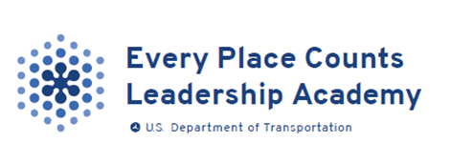
Using plain language and simple graphic design
Launch in October will include beta test of Toolkit
Future Phases will include online library and interactive tool
Question? Write to Citizens Academy - Academy@dot.gov
Notes:
Citizens Academy -Academy@dot.gov

Slide 35
FHWA Contacts
KY Division
John Ballantyne
John.Ballantyne@dot.gov
HQ
Planning, Environment, Realty
Infrastructure
Safety
Operation
Civil Rights
Field
Resource Center

